Slide 1
Chapter Five
functions, variable scope, default parameters and keyword arguments

Slide 2
Functions as Black Boxes
A function is a block of statements with a name.
For example, the round function, which was introduced in Chapter 2, contains instructions to round a floating-point value to a specified number of decimal places.

Slide 3
Calling Functions
We call a function in order to execute its instructions
By using the expression round(6.8275, 2), our program calls the round function, asking it to round 6.8275 to two decimal digits.
price = round(6.8275, 2) # Sets result to 6.83

Slide 4
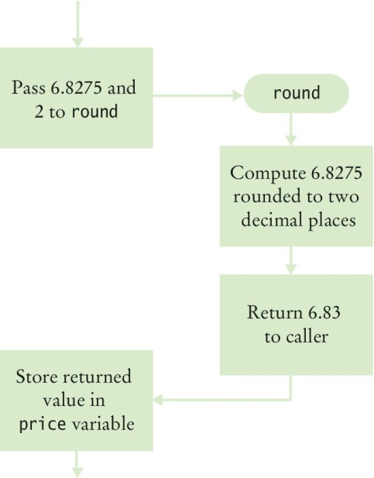
Calling Functions (2)
The round function returns its result back to where the function was called and our program resumes execution

Slide 5
Function Arguments
When another function calls the round function, it provides “input”, such as the values 6.8275 and 2 in the call: round(6.8275, 2)
These values are called the input arguments of the function.
Note that they are not input provided by the user from the keyboard.
They are the values that we send or pass to the function to it can use to do its work.
Functions can receive multiple arguments or it is also possible to have functions with no input arguments.

Slide 6
Function Return Values
The “output” that the round function computes is called the return value.
Functions return only one value.
The return value of a function is returned to the point in our program where the function was called.
When the round function returns its result, the return value is stored in the variable price.
price = round(6.8275, 2)

Slide 7
Black Box Analogy
A thermostat is a ‘black box’
We set a desired temperature.
It turns on the heater/AC as needed.
We don’t have to know how the thermostat really works: How does it know the current temp? What signals/commands does it send to the heater or AC?
When we call a function , we use functions like ‘black boxes.’
Pass the function what it needs to do its job.
It returns the answer.
We don’t need to know how the function is implemented.
For the round function, we just need to know the specification of the function:
If we provide arguments x and n, the function returns x rounded to n decimal digits.

Slide 8
Designing User-Defined Functions
When we design our own functions, we want to make them appear as black boxes to other programmers.
Even if we are the only person writing the entire program, making each function into a black box pays off: there are fewer details that we need to keep in mind.

Slide 9
Implementing and Testing Functions

Slide 10
Implementing Functions
The following are steps to implement or write a function.
Example: write a function to calculate the volume of a cube
Choose a descriptive name of the function: cubeVolume
What input does it need to do its job? The length of one side. Declare a variable for each input argument (sideLength) The variable that stores the argument is called a parameter.
What does it return? The volume
Put the function name and parameters in a function header:
After the function header is the function body, which is the block of code that does the work of the function. The function body is always indented from the function header.
def cubeVolume(sideLength):
def cubeVolume(sideLength) :
volume = sideLength ** 3
return volume

Slide 11
Calling/Testing a Function
Calling / testing the function
result1 = cubeVolume(2)
result2 = cubeVolume(10)
print("A cube with side length 2 has volume", result1)
print("A cube with side length 10 has volume", result2)

Slide 12
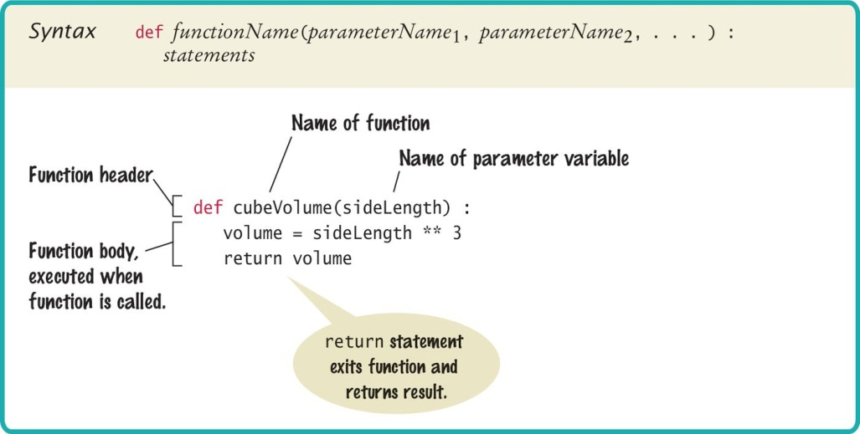
Syntax: Function Definition

Slide 13
Documentation: Docstrings
Whenever we write a function, we should document its behavior.
Documentation for a function follows Python’s docstring convention:
Appear immediately after the function header.
Start with 3 double quotes.
On the same line as the 3 double quotes, a short description of what the function does.
Use action verbs: ask the user for input, calculate the total price, print sales receipt, etc.
Optional: Description of input arguments, return value
End with 3 double quotes on a separate line
If not using the optional description of input arguments and return value, then the docstring can be on one line: """ description of function """

Slide 14
Docstring Examples
Example multi-line docstring:
Example one-line docstring:
def cubeVolume(sideLength) :
""" Calculate the volume of a cube.
Argument: sideLength - the length of one side
Return: the volume of the cube
"""
volume = side ** 3
return volume
def cubeVolume(sideLength) :
""" Calculate the volume of a cube """
volume = side ** 3
return volume

Slide 15
Use of Docstrings
Docstrings are more than lines of text to document a function in the source file.
Docstrings are recognized by the Python interpreter when the code is translated to byte code, therefore docstrings can be extracted by software tools.
One of these software tools is Python’s built-in help() function: it returns the docstring of a function or a data type.
At the shell, type: help(print) to see the documentation for the print() function
At the shell, type: help(str) to see the documentation for the string data type
Other software tools, such as the Wing IDE, can also extract the docstrings in order to provide help to the user.
When we type a Python function name in the text editor, Wing shows the docstring of the function in the Source Assistant tab to remind us how to call the function.

Slide 16
The main Function
When defining and using functions in Python, it is good programming practice to place all statements into functions, and to specify one function as the starting point.
Any legal name can be used for the starting point, but we choose ‘main’ since it is the required function name used by other common languages.
Of course, we must have one statement in the program that calls the main function.

Slide 17
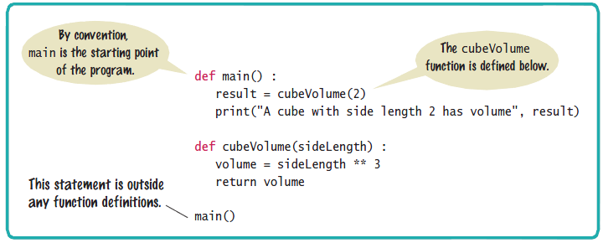
Syntax: The main Function

Slide 18
Using Functions: Order in the Source File
We must define a function before we can call it.
For example, the following will produce a compile-time error:
However, a function can be called from within another function before the former has been defined:
print("Volume is", cubeVolume(10))
def cubeVolume(sideLength) :
volume = sideLength ** 3
return volume
def main() :
print("Volume is", cubeVolume(10))
def cubeVolume(sideLength) :
volume = sideLength ** 3
return volume
main()

Slide 19
Argument Passing

Slide 20
Argument Passing
Parameter variables receive the argument values supplied in the function call
The argument value may be:
The content of a variable
A ‘literal’ value (such as 24)
The parameter variable is:
Declared in the called function
Initialized with the value of the argument value
Used as a variable inside the called function
Calling function
Argument value
out
Parameter variable
in
Called function

Slide 21




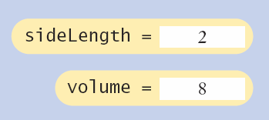
Parameter Passing Steps
result1 = cubeVolume(2)
def cubeVolume(sideLength):
volume = sideLength * 3
return volume

Slide 22
Common Error
Modifying the value of the parameter variable (in the called function) will not change the value of the variable in the calling function.
A copy of the argument values is passed.
Called function (addTax) can modify local copy (price) but not total
total = 10.0
addTax(total, 7.5);
total
copy
10.0
def addTax(price, rate):
tax = price * rate / 100
# No effect outside the function
price = price + tax
return tax;
price
10.75

Slide 23
Return Values

Slide 24
Return Values
Functions can optionally return one value through the return statement.
A return statement does two things:
Immediately terminates the function and goes back to the caller.
Passes the return value (if there is one) back to the caller.
def cubeVolume (sideLength):
volume = sideLength * 3
return volume
return statement
The return value may be a literal value, a variable, or an expression.

Slide 25
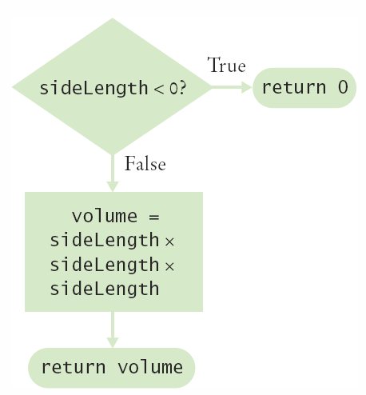
Multiple return Statements (1)
A function can use multiple return statements if there is branching
But every branch must have a return statement.
def cubeVolume(sideLength):
if (sideLength < 0):
return 0
return sideLength * 3

Slide 26
Multiple return Statements (2)
Alternative to multiple returns (e.g., one for each branch):
We can avoid multiple returns by storing the return value in a variable that we return in the last statement of the function.
For example:
def cubeVolume(sideLength) :
if sideLength >= 0:
volume = sideLength ** 3
else :
volume = 0
return volume

Slide 27
Make Sure A Return Catches All Cases
When there are branches that return a value, make sure all branches return a value.
Example: In the cubeVolume function below, sideLength could be 0 but there is no return statement for this condition.
The compiler will not complain if a branch has no return statement.
It may result in a run-time error because Python returns the special value None when we don’t return a value.
Correct implementation:
def cubeVolume(sideLength) :
if sideLength >= 0 :
return sideLength ** 3
def cubeVolume(sideLength) :
if sideLength >= 0
return sideLength ** 3
else :
return 0

Slide 28
Functions Without Return Values

Slide 29

Functions Without Return Values
Functions are not required to return a value.
No return statement is required.
The function can generate output even when it doesn’t have a return value.
# function call
boxString("Hello")
# function definition
def boxString(contents) :
n = len(contents)
print("-" * (n + 2))
print("!" + contents + "!")
print("-" * (n + 2))
Screen output:

Slide 30
Using return Without a Value
We can use the return statement without a return value.
The function will terminate immediately if the return statement is reached. The code after the return statement will not be executed.
def boxString(contents) :
n = len(contents)
if n == 0 :
return # Return immediately
print("-" * (n + 2))
print("!" + contents + "!")
print("-" * (n + 2))
If n is 0, nothing will be printed
When we use return statement without a return value, or when we don’t use a return statement, then the return value is None.
None is a Python data value to indicate “nothing”.

Slide 31
Returning None
None is a Python data value that can be used to test a return value.
If we test for True / False, then None is considered False
But we can also test for the exact value None in the return value
def testPositive(n) :
if type(n) != int :
return None
elif n > 0 :
return True
else :
return False
Test code:
# test with positive
if testPositive(8) : # True
print("8 is positive")
# test with negative
if testPositive(-2) : # False
print("-2 is positive")
# test with non-digit
if testPositive("a") : # None -> False
print("a is positive")
# test for non-number
if testPositive("b") is None : # None -> True
print("b is not a number")
# test for non-number or negative
if not testPositive("b") : # None -> True
print("b is not positive")
Output:
8 is positive
b is not a number
b is not positive

Slide 32
Reusable Functions

Slide 33
Problem Solving: Reusable Functions
Find repetitive code
May have different values but same logic
hours = int(input("Enter a value between 0 and 23: "))
while hours < 0 or hours > 23 :
print("Error: value out of range.")
hours = int(input("Enter a value between 0 and 23: "))
minutes = int(input("Enter a value between 0 and 59: "))
while minutes < 0 or minutes > 59 :
print("Error: value out of range.")
minutes = int(input("Enter a value between 0 and 59: "))
0 - 23
0 - 59

Slide 34
Write a ‘Parameterized’ Function
def readIntUpTo(high) :
""" Prompts a user to enter a value up to a given maximum
until the user provides a valid input
"""
value = int(input("Enter a value between 0 and " + str(high) + ": "))
while value < 0 or value > high :
print("Error: value out of range.")
value = int(input("Enter a value between 0 and " + str(high) + ": "))
return value

Slide 35
Programming Tips
Keep functions short
If it takes more than one screen, break it into ‘sub’ functions
When we write a large program we may not always know how to implement all functions at once. In this case we use stubs as place holders for the functions.
Unfinished functions that return a ‘dummy’ value
Unfinished functions can also have a temporary function body:
def functionA() :
pass # pass is a temporary place holder
# for a function body that will be
# written

Slide 36
Variable Scope

Slide 37
Variable Scope
Variables can be declared:
Inside a function
Known as ‘local variables’
Only available inside this function
Parameter variables are like local variables
Outside of a function
Sometimes called ‘global scope’
Can be used (and changed) by code in any function
The scope of a variable is the part of the program in which it is accessible

Slide 38
Examples of Scope
sum, square & i are local variables in main
Their scope starts where they are defined and end at the end of main
def main() :
sum = 0
for i in range(11) :
square = i * i
sum = sum + square
print(square, sum)
sum
i
square

Slide 39
Local Variables
Variables declared inside one function are not visible to other functions.
Example:
sideLength is local to main
Using it outside main will cause a compiler error
def main():
sideLength = 10
result = cubeVolume()
print(result)
def cubeVolume():
return sideLength * sideLength * sideLength # ERROR

Slide 40
Re-using Names for Local Variables
Variables declared inside one function are not visible to other functions.
result is local to square and result is local to main.
They are two different variables and do not overlap.
def square(n):
result = n * n
return result
def main():
result = square(3) + square(4)
print(result)
result
result

Slide 41
Global Variables
Globals are variables that are defined outside of any function.
A global variable is visible to all functions that are defined after it.
However, any function that wishes to use a global variable must include a global declaration.
In the example below, if we omit the global declaration, then the balance variable inside the withdraw function is considered a local variable:
balance = 10000 # A global variable
def withdraw(amount) :
# This function intends to access the
# global ‘balance’ variable
global balance
balance = balance - amount

Slide 42
Programming Tip
There are a few cases where global variables are required, but they are quite rare.
Programs with global variables are difficult to maintain because we can no longer view each function as a “black box” that receives arguments and returns a result. Since global variables can be changed by any function, we now must keep track of the variables when we call a function.
Instead of using global variables, we should pass input arguments for use in a function, and return values to transfer information from one function to another.

Slide 43
Default Parameters and Named Arguments

Slide 44
Optional Arguments
Python functions can have optional arguments.
When calling a function with an optional argument, we don’t have to pass in any value for the optional argument.
Example: the documentation of the built-in round() function shows
number is a required argument, ndigits is an optional argument. The [ ] shows optional arguments.
When calling round() we need at minimum one argument, and we can optionally have a second argument:
Output: 3.87 (round to 2 digits)
4 (no ndigits value means round to a whole number)
round(number[, ndigits])
round(3.87384, 2)
round(3.87384)

Slide 45
Default Parameter Value (1)
For a function to have optional arguments, in the function definition header the optional parameter must have a default value.
Parameters that have default values are called default parameters.
If the caller doesn’t pass in a value for the optional argument, then this argument gets the default value. Otherwise, the passed in value has higher precedence.
Example:
Output: Name: Fred, age: 36 Name: Wilma, age: 20
def printInfo(name, age = 20):
print("Name: {}, age: {}".format(name, age))
printInfo("Fred", 36)
printInfo("Wilma")

Slide 46
Default Parameter Value (2)
In a parameter list, if a parameter has a default value, then the rest of the parameters following it must have default values.
Example:
def printInfo(name, age=20, employed=False): # OK
# code for body of function
def printInfo(name, age=20, employed): # Error
# code for body of function

Slide 47
Named or Keyword Arguments (1)
When calling a function with multiple arguments, by default we must pass arguments in the required order.
However, if we explicitly name the arguments in the function call, then we can pass arguments in any order.
Example:
Output: Name: Fred, age: 36
Name: Fred, age: 36
def printInfo(name, age=20):
print("Name: {}, age: {}".format(name, age))
printInfo("Fred", 36)
printInfo(age=36, name="Fred")

Slide 48
Named or Keyword Arguments (2)
When calling a function with multiple default arguments and we only want to pass data to some of them, we must name the default parameter to which we want to pass data. Otherwise we must pass all data in the order listed in the argument list.
Example:
Run:
def printInfo(name, age=20, location="Cupertino",
employed=False, occupation="student",
address="unknown", status="single",
affiliation=None):
# code to print information here
printInfo("Fred", occupation=“crane operator”, employed=True)
printInfo("Fred", 40, "Bedrock", status="married")

Slide 49
Recursive Functions

Slide 50
Recursive Functions
A recursive function is a function that calls itself.
A recursive computation solves a problem by using the solution of the same problem with simpler input.
For a recursion to terminate, there must be special cases for the simplest input.

Slide 51
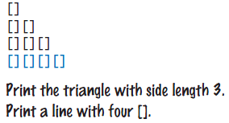
Recursive Triangle Example
def printTriangle(sideLength) :
if sideLength < 1 : return
printTriangle(sideLength - 1)
print("[]" * sideLength)
Special Case
Recursive Call
The function will call itself (and not output anything) until sideLength becomes < 1
It will then use the return statement and each of the previous iterations will print their results
1, 2, 3 then 4

Slide 52
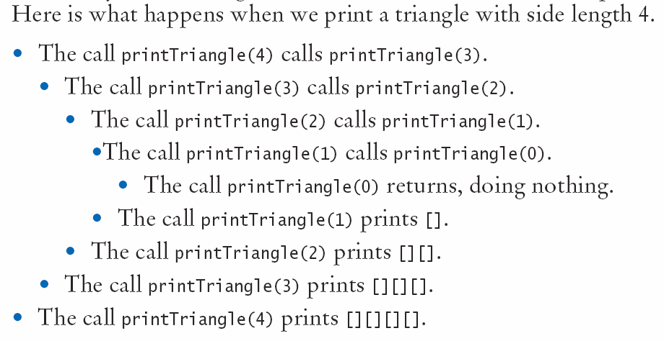
Recursive Calls and Returns

Slide 53
When to Use Recursion
Recursion typically takes more memory than using a loop.
Recursive calls can also be harder to “read” (understand).
Therefore use recursion only when each successive recursive call works with a smaller input data set
If the subsequent input data is not smaller, use a loop to repeat code instead.
def printTriangle(sideLength) :
if sideLength < 1 : return
printTriangle(sideLength - 1)
print("[]" * sideLength)
starting data set
subsequent data set
is smaller by 1

Slide 54
End of Chapter 5 Notes

